Slide 1
Lab 4-5: Image Filtering
CSE 4118 : Computer Vision and Image Processing Laboratory
Kazi Saeed Alam, Assistant Professor, Dept of CSE, KUET
email: saeed.alam@cse.kuet.ac.bd

Slide 2
Image Processing
Image processing is converting an image to a digital format and applying various functions to it to create a better image or extract additional information from it.
Digital Image: is present in pixelated form.
Grayscale Image: Every pixel size is one byte and has a variation of 256 colors from black to white.
Color Image: composed of multiple color channels, each representing the intensity of a specific color or perceptual feature. The most common color models:
RGB(Red, Green, Blue),
HSI(Hue, Saturation, Intensity), and
HSV(Hue, Saturation, Value).

Slide 3
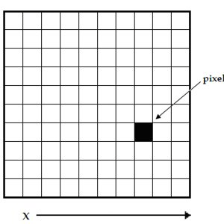
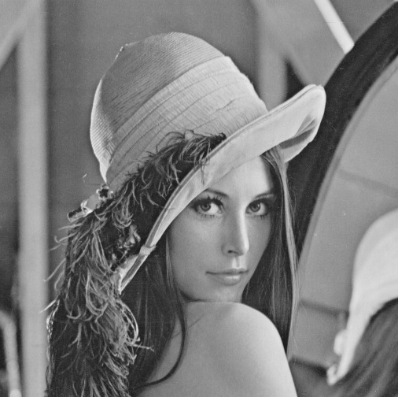
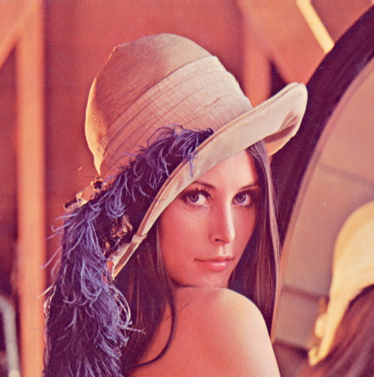
Digital Image
x
y
Grayscale Image
Color image in RGB space

Slide 4
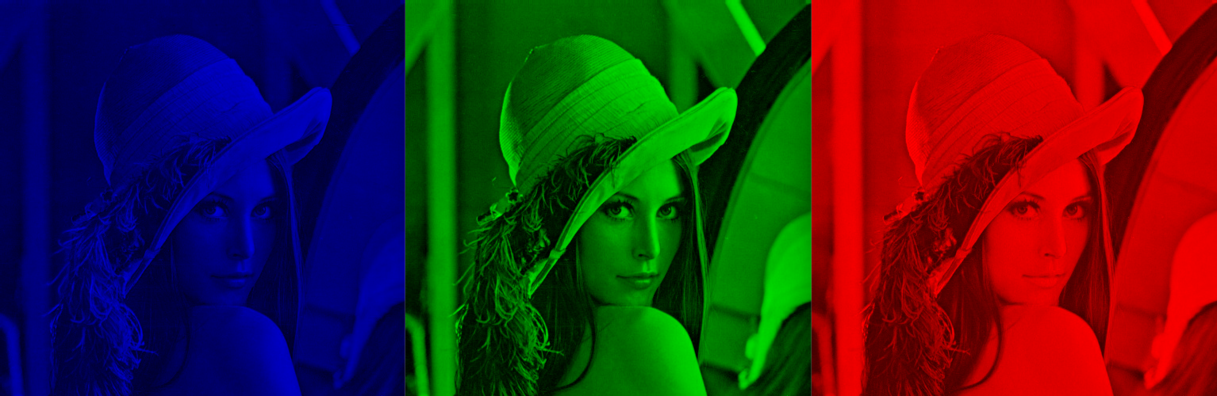
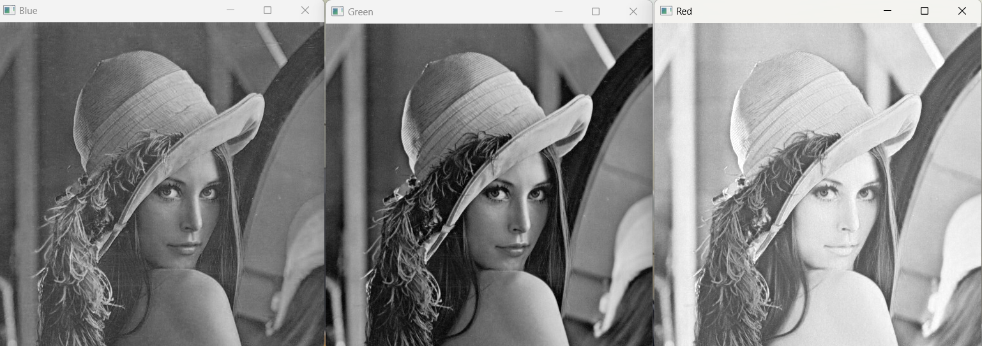
Digital Image
Color image in RGB space
Figure(Left to right): Blue, Green, Red Channel

Slide 5
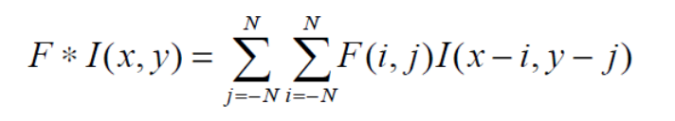
Convolution
Convolution is an operation performed on two functions to produce a third function.
In image processing, convolution is the process of transforming an image by applying a kernel over each pixel and its local neighbors across the entire image.
The convolution operation applied on Image I(x,y) using a kernel F is given by

Slide 6
Convolution
1 | 1 | 0 | 1 | 0
0 | 0 | 1 | 0 | 0
0 | 1 | 0 | 0 | 1
1 | 0 | 1 | 0 | 1
0 | 1 | 1 | 1 | 0
0 | 0 | 0 | 0 | 0
0 | 0 | 0 | 0 | 0
0 | 0 | 0 | 0 | 0
0 | 0 | 0 | 0 | 0
0 | 0 | 0 | 0 | 0
1 | 2 | 3
4 | 5 | 6
7 | 8 | 9
F
I(X,Y)
F * I(X,Y)

Slide 7
Convolution
1X9 | 1X8 | 0X7 | 1 | 0
0X6 | 0X5 | 1X4 | 0 | 0
0X3 | 1X2 | 0X1 | 0 | 1
1 | 0 | 1 | 0 | 1
0 | 1 | 1 | 1 | 0
0 | 0 | 0 | 0 | 0
0 | 23 | 0 | 0 | 0
0 | 0 | 0 | 0 | 0
0 | 0 | 0 | 0 | 0
0 | 0 | 0 | 0 | 0
1 | 2 | 3
4 | 5 | 6
7 | 8 | 9
F
I(X,Y)
F * I(X,Y)

Slide 8
Convolution
1 | 1X9 | 0X8 | 1X7 | 0
0 | 0X6 | 1X5 | 0X4 | 0
0 | 1X3 | 0X2 | 0X1 | 1
1 | 0 | 1 | 0 | 1
0 | 1 | 1 | 1 | 0
0 | 0 | 0 | 0 | 0
0 | 23 | 24 | 0 | 0
0 | 0 | 0 | 0 | 0
0 | 0 | 0 | 0 | 0
0 | 0 | 0 | 0 | 0
1 | 2 | 3
4 | 5 | 6
7 | 8 | 9
F
I(X,Y)
F * I(X,Y)

Slide 9
Convolution
1 | 1 | 0 | 1 | 0
0 | 0 | 1 | 0 | 0
0 | 1 | 0 | 0 | 1
1 | 0 | 1 | 0 | 1
0 | 1 | 1 | 1 | 0
0 | 0 | 0 | 0 | 0
0 | 23 | 24 | 15 | 0
0 | 0 | 0 | 0 | 0
0 | 0 | 0 | 0 | 0
0 | 0 | 0 | 0 | 0
1 | 2 | 3
4 | 5 | 6
7 | 8 | 9
F
I(X,Y)
F * I(X,Y)

Slide 10
Convolution
1 | 1 | 0 | 1 | 0
0 | 0 | 1 | 0 | 0
0 | 1 | 0 | 0 | 1
1 | 0 | 1 | 0 | 1
0 | 1 | 1 | 1 | 0
0 | 0 | 0 | 0 | 0
0 | 23 | 24 | 15 | 0
0 | 16 | 0 | 0 | 0
0 | 0 | 0 | 0 | 0
0 | 0 | 0 | 0 | 0
1 | 2 | 3
4 | 5 | 6
7 | 8 | 9
F
I(X,Y)
F * I(X,Y)

Slide 11
Convolution
1 | 1 | 0 | 1 | 0
0 | 0 | 1 | 0 | 0
0 | 1 | 0 | 0 | 1
1 | 0 | 1 | 0 | 1
0 | 1 | 1 | 1 | 0
0 | 0 | 0 | 0 | 0
0 | 23 | 24 | 15 | 0
0 | 16 | 16 | 0 | 0
0 | 0 | 0 | 0 | 0
0 | 0 | 0 | 0 | 0
1 | 2 | 3
4 | 5 | 6
7 | 8 | 9
F
I(X,Y)
F * I(X,Y)

Slide 12
Convolution
1 | 1 | 0 | 1 | 0
0 | 0 | 1 | 0 | 0
0 | 1 | 0 | 0 | 1
1 | 0 | 1 | 0 | 1
0 | 1 | 1 | 1 | 0
0 | 0 | 0 | 0 | 0
0 | 23 | 24 | 15 | 0
0 | 16 | 16 | 17 | 0
0 | 0 | 0 | 0 | 0
0 | 0 | 0 | 0 | 0
1 | 2 | 3
4 | 5 | 6
7 | 8 | 9
F
I(X,Y)
F * I(X,Y)

Slide 13
Convolution
1 | 1 | 0 | 1 | 0
0 | 0 | 1 | 0 | 0
0 | 1 | 0 | 0 | 1
1 | 0 | 1 | 0 | 1
0 | 1 | 1 | 1 | 0
0 | 0 | 0 | 0 | 0
0 | 23 | 24 | 15 | 0
0 | 16 | 16 | 17 | 0
0 | 21 | 0 | 0 | 0
0 | 0 | 0 | 0 | 0
1 | 2 | 3
4 | 5 | 6
7 | 8 | 9
F
I(X,Y)
F * I(X,Y)

Slide 14
Convolution
1 | 1 | 0 | 1 | 0
0 | 0 | 1 | 0 | 0
0 | 1 | 0 | 0 | 1
1 | 0 | 1 | 0 | 1
0 | 1 | 1 | 1 | 0
0 | 0 | 0 | 0 | 0
0 | 23 | 24 | 15 | 0
0 | 16 | 16 | 17 | 0
0 | 21 | 20 | 0 | 0
0 | 0 | 0 | 0 | 0
1 | 2 | 3
4 | 5 | 6
7 | 8 | 9
F
I(X,Y)
F * I(X,Y)

Slide 15
Convolution
1 | 1 | 0 | 1 | 0
0 | 0 | 1 | 0 | 0
0 | 1 | 0 | 0 | 1
1 | 0 | 1 | 0 | 1
0 | 1 | 1 | 1 | 0
0 | 0 | 0 | 0 | 0
0 | 23 | 24 | 15 | 0
0 | 16 | 16 | 17 | 0
0 | 21 | 20 | 22 | 0
0 | 0 | 0 | 0 | 0
1 | 2 | 3
4 | 5 | 6
7 | 8 | 9
F
I(X,Y)
F * I(X,Y)

Slide 16
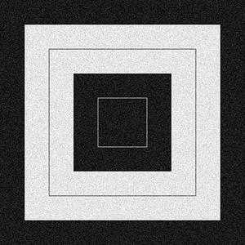
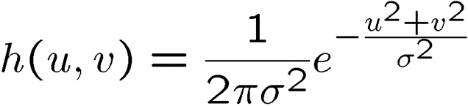
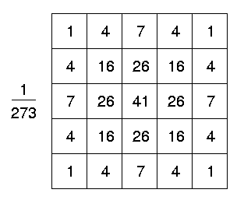
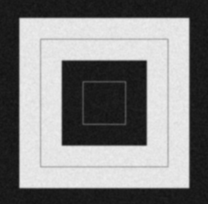

Classwork
Input
Output

Slide 17
Classwork
Apply Convolution using both smoothing and sharpening kernels on a grayscale image and output the results.
Repeat the process for the Color image:
Take an RGB image and apply convolution with each kernel, applying convolution separately on each channel.
Convert the RGB image to HSV mode and apply convolution on V channel of HSV space.
Subtract the resulting image obtained from the RGB and HSV modes to distinguish their differences.
Repeat (2) for both smoothing and sharpening kernels.

Slide 18
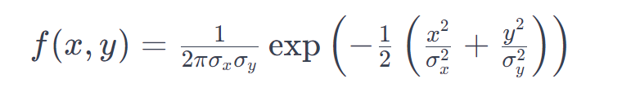
Classwork
Instructions for Filters:
Use smoothing filters like the Gaussian blur filter and Mean filter.
For the Gaussian filter, create a filter function with parameters σ_{x}, σ_{y} (which will be user-input) such that it satisfies:
Use Sharpening filters like the Laplacian filter, and Laplacian of a Gaussian (LoG) filter for each operation.
Try with the Sobel filter.

Slide 19
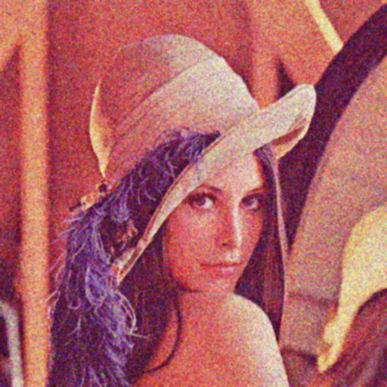

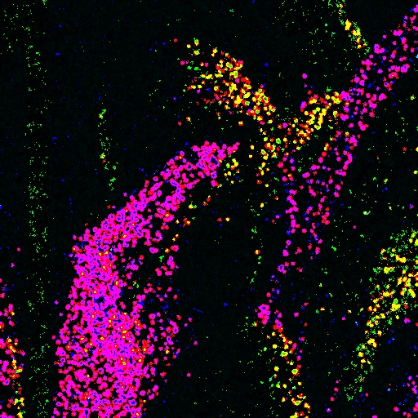

Classwork
Applying Gaussian filter
Convoluted in RGB space
Input image
Difference between the outputs
Convoluted in HSV space

Slide 20
Classwork
Apply Prewitt operator using Convolution:
It works like as first order derivate and calculates the difference of pixel intensities in a edge region.
-1 | 0 | 1
-1 | 0 | 1
-1 | 0 | 1
-1 | -1 | -1
0 | 0 | 0
1 | 1 | 1
G_{x} will find the edges in the horizontal direction
G_{y} will find edges in the vertical direction

Slide 21

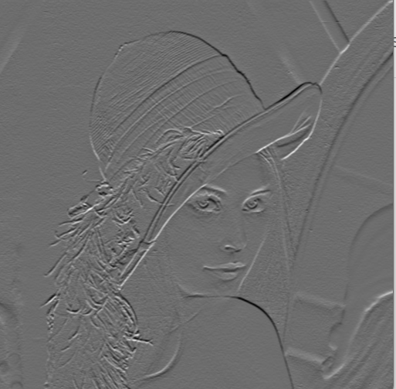
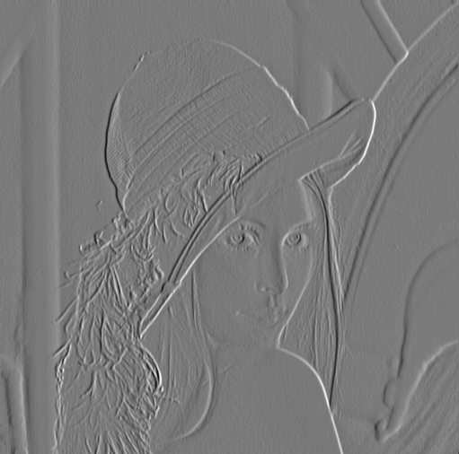
Classwork
Input
Applying G_{x}
Applying G_{y}

Slide 22
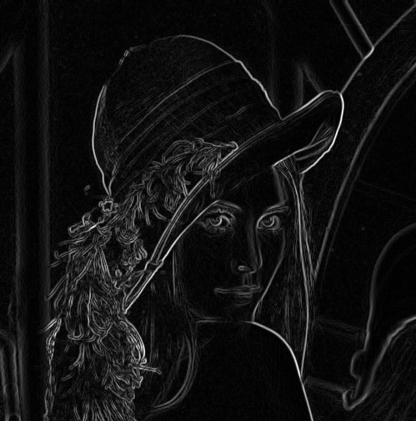

Classwork
Gradient Magnitude

